Slide 1
HOME SHARING in BC
Inclusion BC Conference
May 28, 2015
Vancouver, B.C
Sara Lige, Rachelle Hole, Tim Stainton & Jordan Lige

Slide 2
What is Home Sharing?
Home sharing is a residential living arrangement in which one or more adults with an intellectual disability shares a home with an individual or family who is contracted to provide residential and at times additional support as needed; the caregiver is paid for her/his caring labour

Slide 3
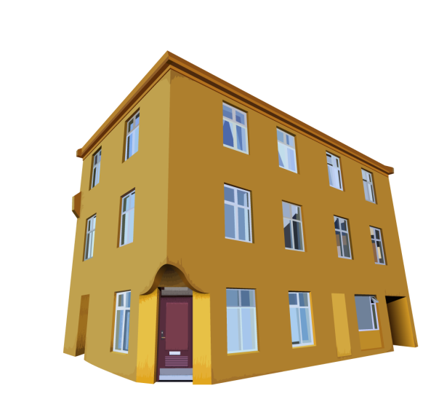
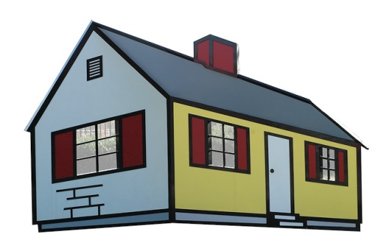
Shared living is used to describe a range of living arrangements:
Homes that are owned or rented by the HSP or the self advocate
The home share providers’ family may live in the home
People living together as roommates
The people involved may have close relationships and share their lives together or they have more of an independent relationship.
Home sharing reflects a great diversity of practice

Slide 4
Literature
Literature supports that community-based residential arrangements are better than institutions (e.g., Chou, Pu, Kroger, Lee & Chang, 2011; Cocks & Boaden, 2011; Crawford, 2005; Stancliffe & Keane, 2000; Stancliffe et al., 2007; Wehmeyer & Bolding, 2001).
Smaller size within the community are associated with more desirable outcomes (e.g., Lakin et al., 2006; Stancliffe & Lakin, 2005; Stancliffe et al., 2009)
Semi-independent living and supported living is a more cost-effective alternative to group homes (Emerson, 1999; Emerson et al., 2001; Howe et al., 1998) and yield more favourable outcomes in terms of personal control and choices (Cocks & Boaden, 2011; Duvdevany & Arar, 2004; Emerson et al., 2001; Stancliffe & Lakin, 2005; Stancliffe, et al., 2007; Stainton et al., 2011).
Research tends to support a call for a greater variety of community living arrangements that facilitate social inclusion for people with ID (Stainton et al., 2006).

Slide 5
Benefits of Home Sharing
Home share can provide unique residential support in a way that enhances quality of life by balancing both independence and support.
Ideally, home sharing as a residential option supports choice, community living, and active participation in community

Slide 6
Purpose of this Research
To explore the home share experiences of adults with intellectual disabilities, home share providers, and family members.
Identify positive and negative factors that contribute to both successful and unsuccessful home shares
This discussion is based on our analysis of interviews with individuals with intellectual disabilities living in home share arrangements, home share providers, and family members – the experts.

Slide 7
METHODS of Data Collection
Qualitative study
Data collection – (face to face and telephone interviews)
The goal was to gather in-depth information about home sharing experiences
All names and places have been changed
in quotes used in this presentation.

Slide 8
Data Analysis
Invitation to Participate at Research Workshop
INTERVIEWS
DATA
Data transcribed, coded and analyzed
Final Report
Data was analyzed
using NVIVO software

Slide 9
Description of study participants
Participants:
At time of interview, how many Self Advocates lived in the Home Share ?
1 | 22
2 | 10
3 | 2
4 or more | 0
Participants | Interior | Lower Mainland | Van. Is./ Sunshine Coast | Central and Northern BC | Total #
# of Self Advocates | 7 | 6 | 8 | 1 | 22
# of HS Providers | 11 | 8 | 12 | 2 | 33
# of Family Members | 5 | 3 | 5 |  | 13
Total Interviews - |  |  |  |  | 68

Slide 10
Participants
Age & Gender of Home Share Providers Represented in Study
Age |  | Male | Female
19 – 30 years | 2 | 7 | 33
31 – 40 years | 5
41 – 50 years | 13
51 – 60 years | 15
61 – 70 years | 5
71 years & over | 0
Total # of Home Share Providers Represented → |  |  | 40
Home Share Providers: Years of experience as a HSP?
0 - 2 | 20
3 – 5 years | 6
6 – 10 years | 5
11 – 20 years | 8
over 20 years | 2
Total # of HSPs represented | 40

Slide 11
Participants
Age & Gender of Self Advocates Represented in Study
Age |  | Male | Female
19 – 30 years | 26 | 35 | 25
31 – 40 years | 10
41 – 50 years | 10
51 – 60 years | 9
61 – 70 years | 4
71 years & over | 1
Total # of Self Advocates Represented → |  |  | 60

Slide 12
Self Advocates: Range of Need
# of Self Advocates represented in study: 52
Developmental Disability + Mobility/Sensory Impairment (e.g., hearing, visual, mobility ) | 24
Developmental Disability + Medical Concerns (e.g., FAS, brain injury, CP, FAS, dual diagnosis, diabetes, seizures, incontinence, aging) | 37
Indicated Behavioural Challenges | 25
Described as “independent” | 24

Slide 13
KEY FACTORS: 1) Importance of the good match
…when it works well, it works really well. It’s more than home sharing. It’s life sharing. You’re having an income, but that person is also a part of your family. .… You know, if the relationship and the match isn’t right, it’s not going to work because you’re sharing your life. It’s not a job that has a shift and you’re off. You’re sharing your life with somebody and so it has to be a good match. (HSP#20)
I love it here… I still
love it here, yeah.
I really love these people. (SA #46 )

Slide 14
2) Creating a “good match”
a) Understanding the motivation and reasons for being a home share provider
HSPs → valuing diversity, making a contribution honouring family commitments, money
FMs → a natural transition, independence, preference
SAs → “time to move out”, opportunity to transition to a more independent option, preference

Slide 15
b) Seeking home share providers that have an existing “skill set”
Previous experience in the community living sector and working with individuals with disabilities was an asset
Not just about experience - it involved a “skill set” and a depth of understanding about how to support an individual with a disability that balanced providing support and promoting independence.
I feel I have quite a few skills that I can offer the client. I have an ability to work with people and always have. I’d been working with people with developmental disabilities for about thirty-five years. And I don’t particularly like being retired. (HSP# 74)

Slide 16
c) Engaging in proactive planning
Communicating expectations
Obtaining full information about the self-advocate
Planning for the transition period
“Do the upfront planning with the person and the agency around developing a relationship. How’s it going to actually look? Do trial visits. Get to know the people that will be involved and how you’re going to work together” (HSP#2).

Slide 17
d) Building on or creating a strong connection
Building on previous connections contributed to a good match
When there wasn’t an existing relationship, participants stressed the importance of fostering a relationship prior to entering the home share, possibly through visits or respite
“I was out there last summer with my dog and swimming with my friends, and that’s how we met. We’d hang out and chat in the parking lot. John would play with my dog and I’d always swim to the cliffs where he was, then in late September his agency came to me and said, “Would you like to have him live with you?” So that’s how it happened. (HSP#74)

Slide 18
e) Ensuring teamwork that includes everyone
home share family
CLBC employees
family members
home share provider
self advocate
support workers
home share agency

Slide 19
f) Understanding the relational dynamics
Relationships between self-advocates and home share providers were diverse.
Both self-advocates and home share providers indicated preferences for varying levels of independence and privacy
Participants said that it was important to consider all relationships in the home share

Slide 20
3) Sustaining the Match
Interviews revealed insights into how to sustain a match over time.
These involved the supports required to maintain and strengthen the home share relationships
Emotional support
Instrumental supports
Practical support
Healthy communication
“We give her breaks. We’re so close. We’re really a safety net for our daughter’s provide” . (FM#18).

Slide 21
3) Sustaining the Match (cont.)
Importance of balancing independence and
providing support:
Flexibility
Tensions between encouraging self determination and concerns around ability and safety
“I think [the relationship] will always evolve, right?” (HSP#29).

Slide 22
4) Safety & Monitoring
Safety - was a concern discussed by self advocates, home share providers and family members
Monitoring - Some home share providers stressed the need for quality monitoring policies and practices and more frequent monitoring, as did several family members.
‘It’s not like our son shouldn’t have rights, but he has a right to be safe!’” (FM#3)

Slide 23
DISCUSSION
Importance of the match between the self advocate and the home share provider
Positive home share experiences are primarily related to other factors such as
the quality of the relationship(s)
planning, preparation and support for the transition
and larger policies and structures to ensure support to individuals participating in home shares
Positive outcomes are related to:
Flexibility and appropriate supports to address changing needs
Home share arrangements that support a self advocate’s healthy lifestyle, well-being, valued social roles, social inclusion, and community participation

Slide 24
DISCUSSION (cont.)
Call for improved safety and monitoring of home sharing practices in BC.
Findings clearly indicate a need to support the provision and implementation of safe and inclusive home sharing that promote the inclusion and citizenship of individuals with intellectual disabilities in community.

Slide 25
“HOME” →
It’s not about place!
It’s about relationships!
We really like this guy, right? For me that’s sort of one of my core beliefs about home sharing and part of what motivated me to...switch gears…right? I think that the potential for the best home shares come when there’s connection and relationship…right? (HSP #2)

Slide 26
Thank you
www.cic.arts.ubc.ca
Contact: Dr. Rachelle Hole
Co-Director, Centre for Inclusion and Citizenship
http://cic.arts.ubc.ca/
email: rachelle.hole@ubc.ca
Website: http://www.ubc.ca/okanagan/socialwork/faculty/rhole.html
Phone: 250 – 807 - 8741

